Slide 1
Datasets and labs
By: Team Solo Mission
aka
Hojin Ryoo

Slide 2

Introduction
Applied Data Science Major
AppleTree office park
Application Database Services
Murray Richburg
Database Administration
Enterprise Database Services
David Eyerly
Database Design

Slide 3

What is Neo4j?
Leading graph database built with Java
Uses the property graph model and Cypher query language
Data Visualization and Pattern Recognition
Machine Learning capabilities
Project Breakdown
Sample Dataset
Training Modules

Slide 4
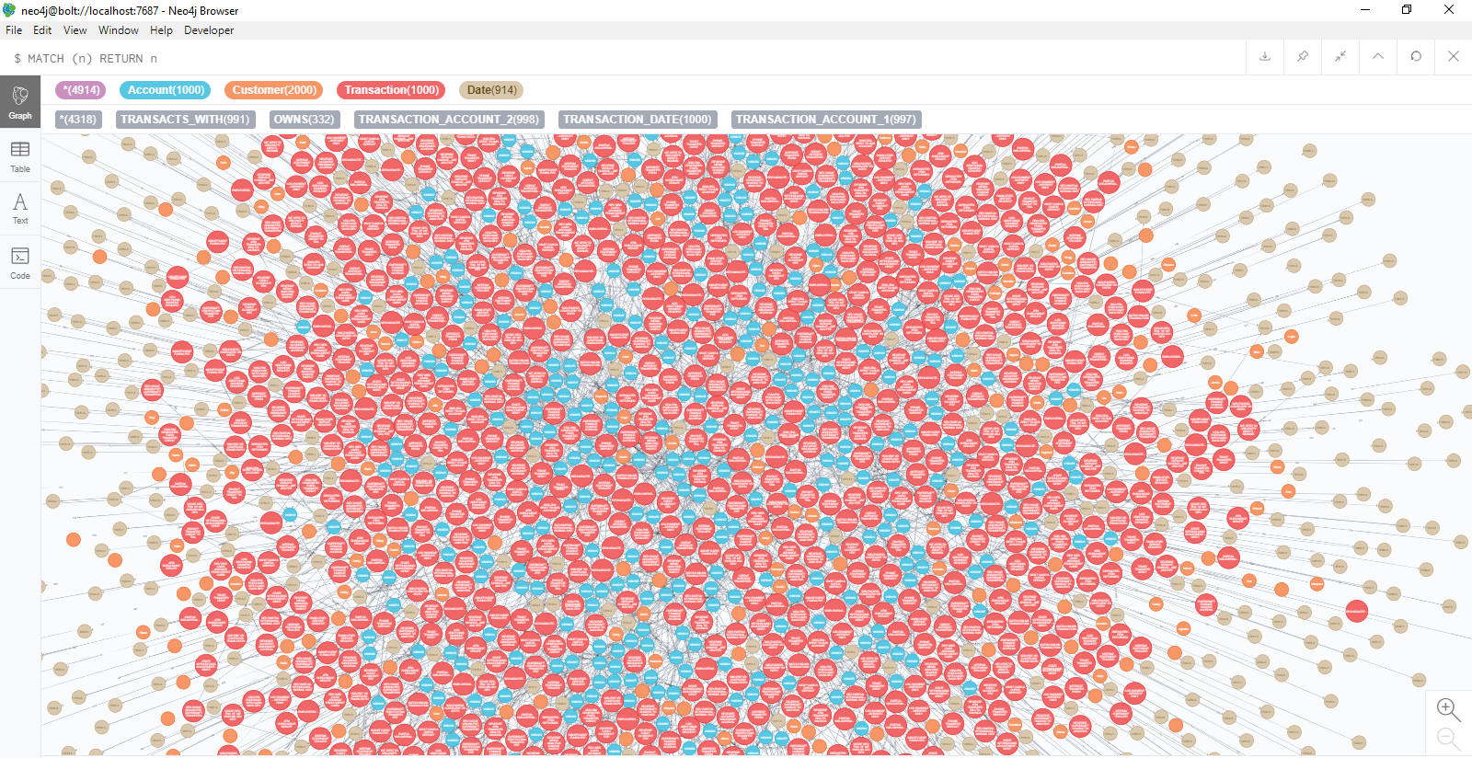
Sample Dataset
Created an example dataset for transactional data
Consists of Customers, Accounts, Transactions
Many properties attached to make dataset more realistic
Scaled up to 5000 data entries
Refined during internship

Slide 5
Demo

Slide 6
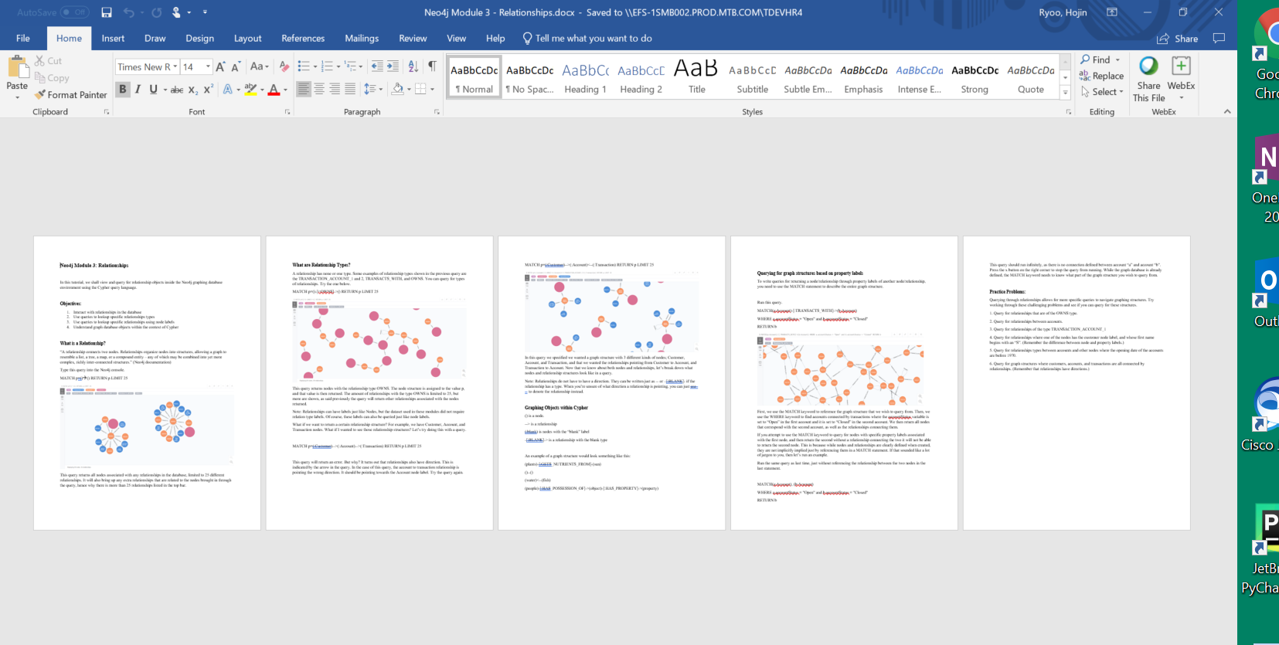
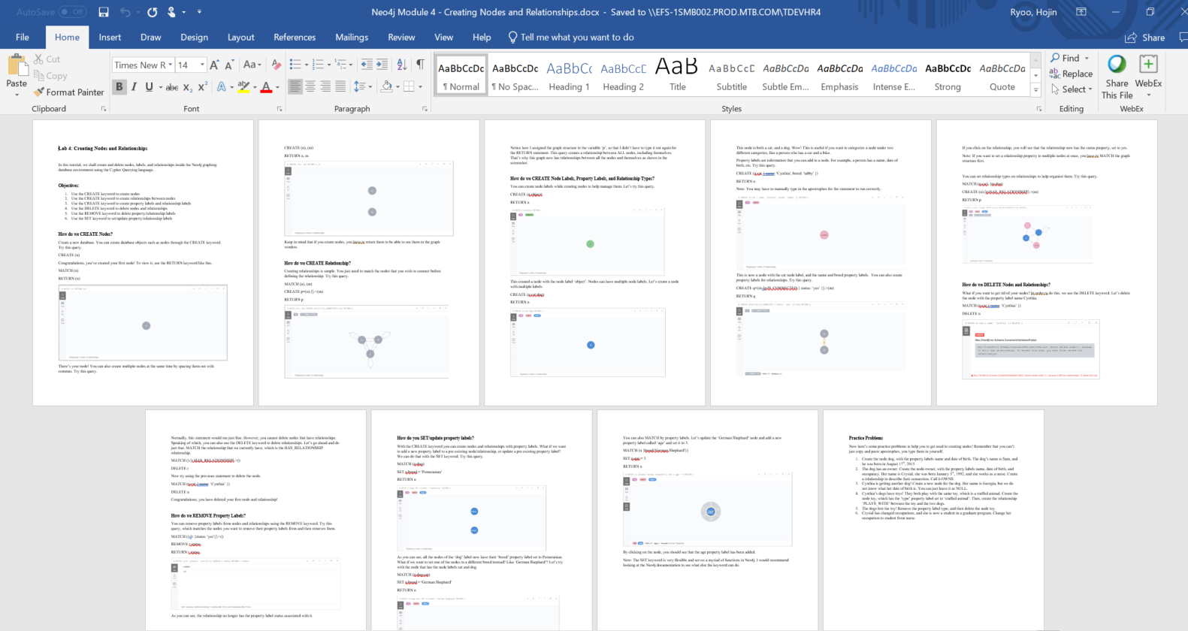
Training Modules
Tasked with creating modules for employees to learn how to use Neo4j
5 modules total
Starting and Importing
Nodes
Relationships
Creating Nodes and Relationships
Complex Queries

Slide 7
Demo

Slide 8
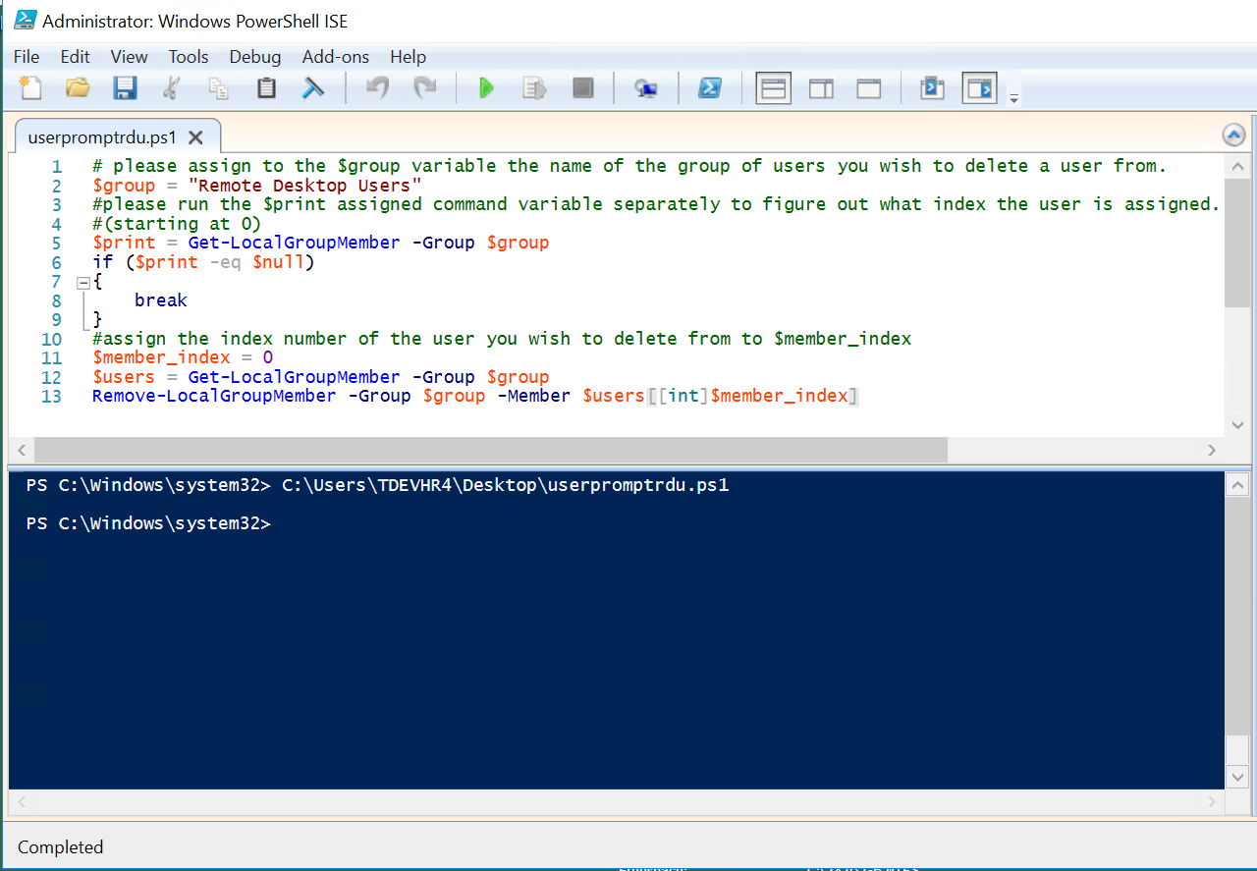
PowerShell (IT Admin)
Automated DBA Tasks through Microsoft PowerShell
PowerShell Scripts
Progress updates on a week by week basis
Ex. Deleting administrator groups from userbase

Slide 9

Impact
Neo4j
Leverage Neo4j as a data visualization/pattern recognition tool
Best use cases in fraud for suspicious patterns among transactional and customer relationships
Training Modules
Provide insight into Neo4j data visualization and why its useful in its own unique way
Inform of specific applications of Cypher querying language

Slide 10
Personal Experience
Enjoyed working with both project teams and meeting other interns
Integrated into scrum team with other interns at AppleTree
Gained a lot of career path knowledge/advice
Gained a better understanding of my dream role as a Data Scientist
Gained professional environment experience

Slide 11
Thank you

